Slide 1
Deliverable 3 Demo
Brandi Durham, Austin Hollis, Justin Willis

Slide 2
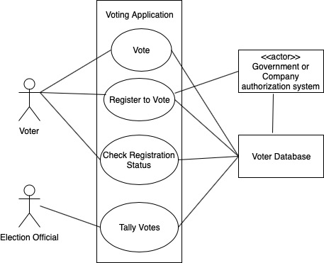
Use Case Diagram

Slide 3
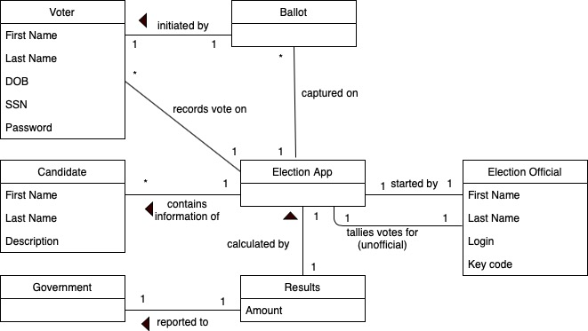
Domain Model

Slide 4
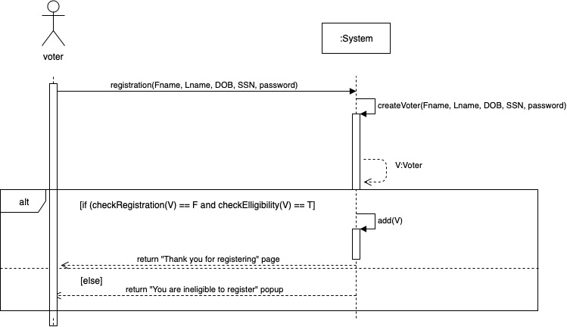
SSD - Voter Registration

Slide 5
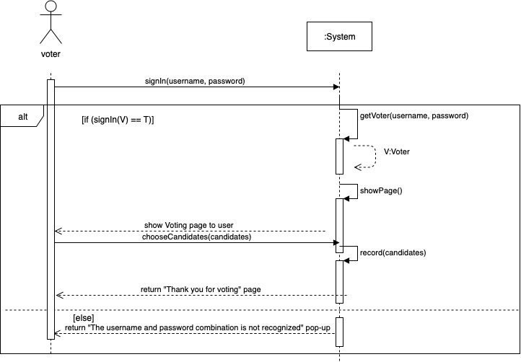
SSD - Voting

Slide 6
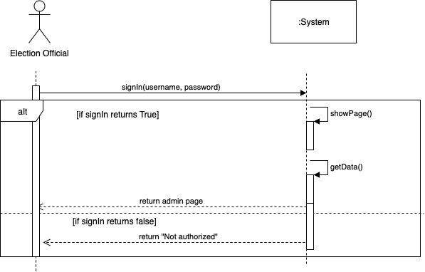
SSD - Election Official Page

Slide 7
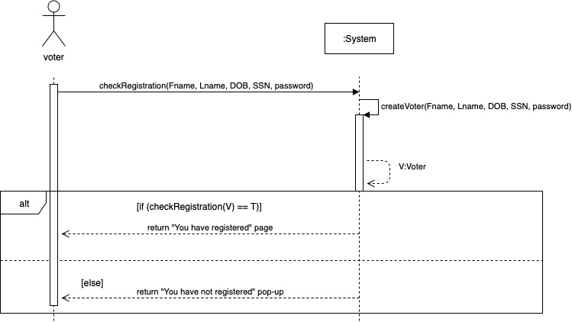
SSD - Check Registration Status

Slide 8
UI Demo

